Slide 1
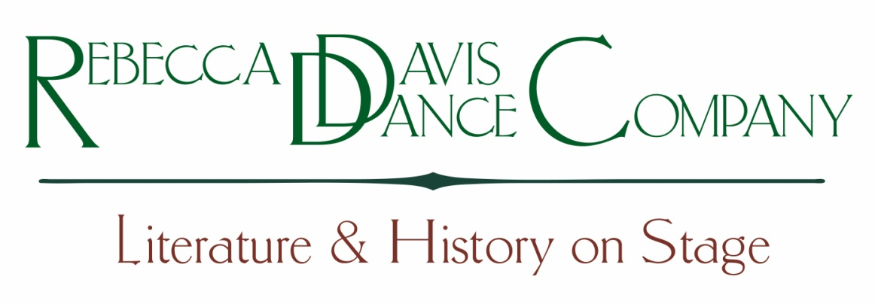
Creative Arts
Water Conservation Program:
Community Awareness &
Public Performance
June 8, 2011
www.rebeccadavisdance.com

Slide 2
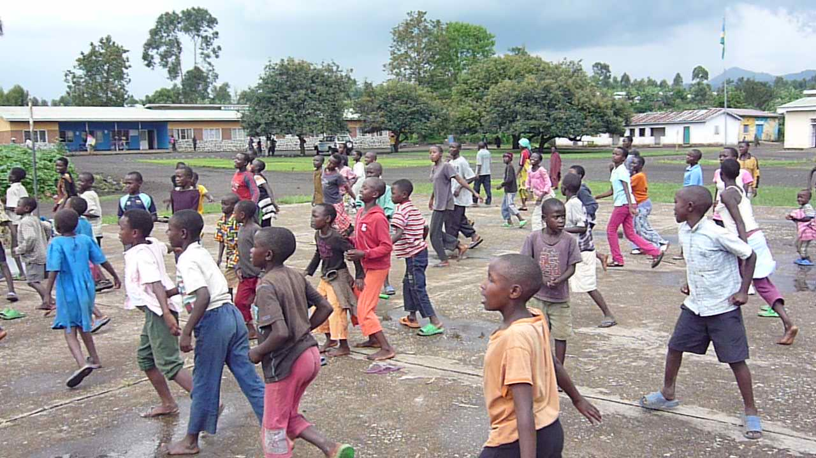
Educating Through the Arts
Rebecca Davis Dance Company (RDDC) has developed a program that uses dance as a tool of youth engagement to raise awareness among individuals and communities on the importance and scarcity of water.
The program serves as a model that can be replicated for other issues such as HIV prevention and gender-based violence.

Slide 3
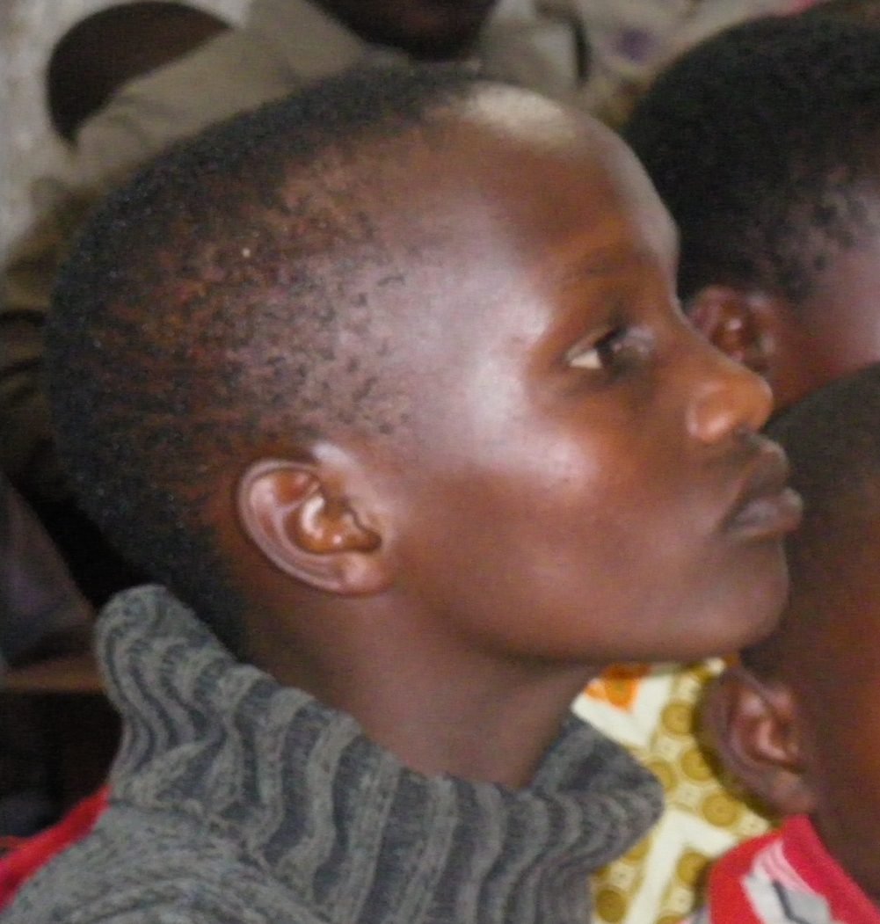
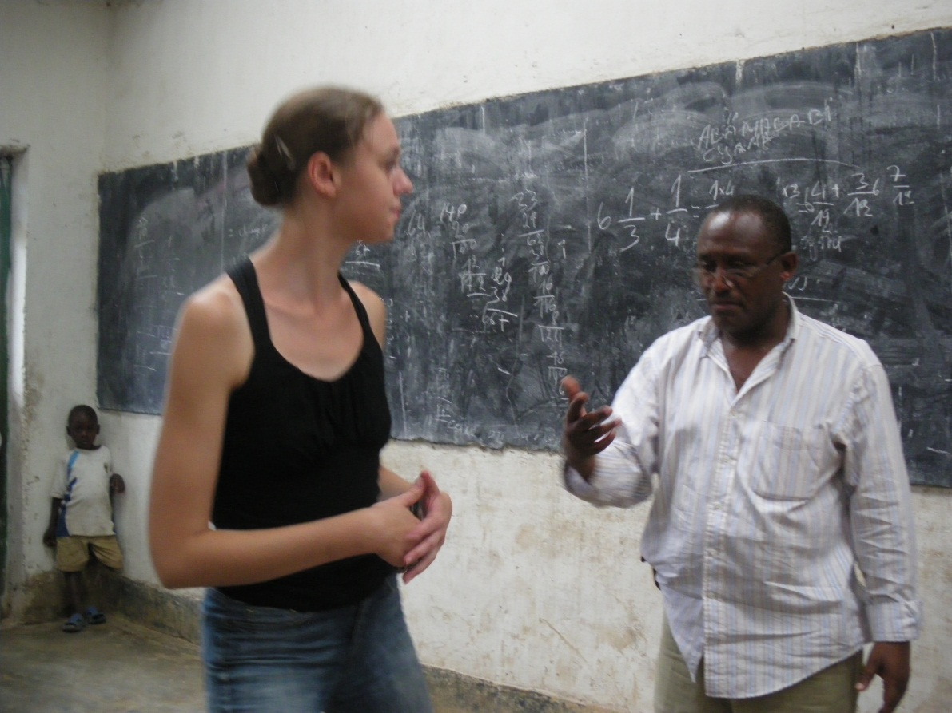
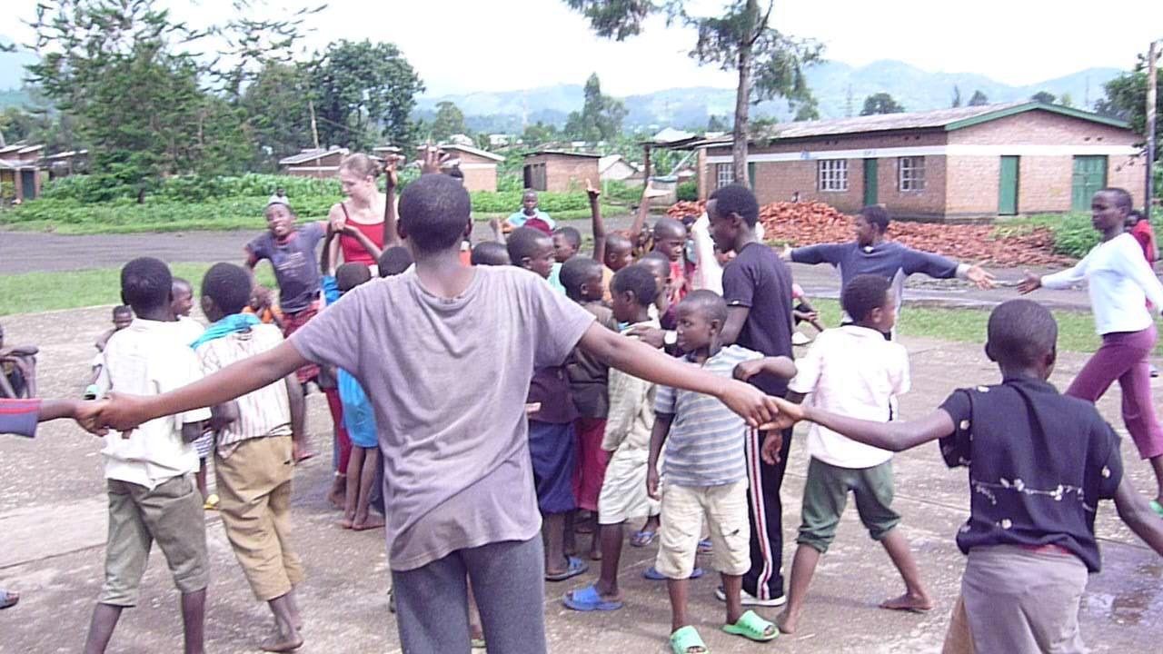
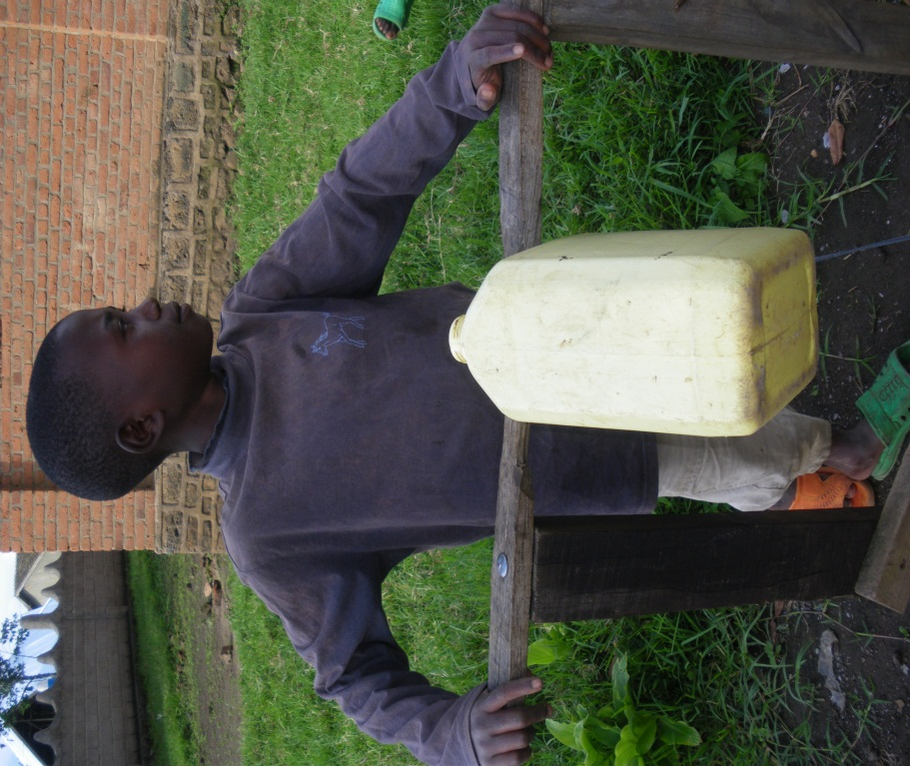

Slide 4
Community Education
RDDC has developed a program that utilizes the power of dance-theatre to improve water conservation in villages where a lack of water affects the overall level of health of the population
Children participate in dynamic dance workshops that integrate lessons of water practices and health with movement and choreography

Slide 5
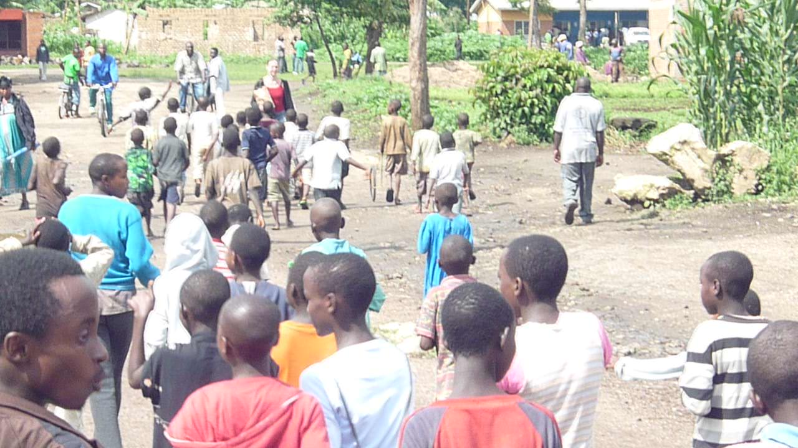

Slide 6
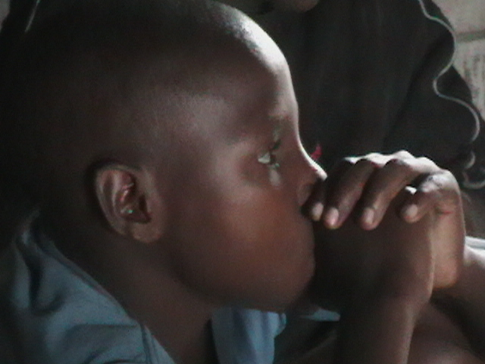
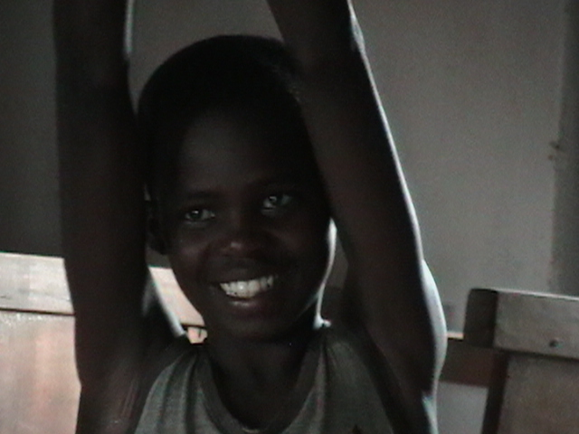
Objectives of Community Component
To improve the health of community villages through better water practices
To increase water conservation by increasing the efficiency of water usage in multiple countries
To engage 500 children in 5 different communities over 12 months
To present children’s dance-theatre works about water to 10,000 – 15,000 adults over 12 months

Slide 7
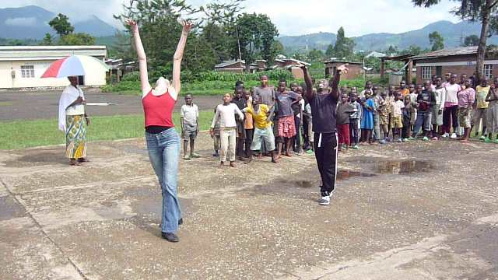
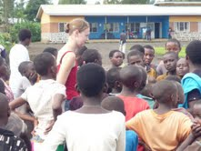
Structure of Community Component
RDDC engages 100 children in a community to participate in a 6-week dance workshop
Each workshop includes a technical dance class followed by a group conversation about water practices in the village
Students contribute ideas to how water could be better managed and these solutions become the substance of a dance-theatre choreographic work that is presented by the children to the wider adult community at the conclusion of the program. Thus, children become informed educators.

Slide 8
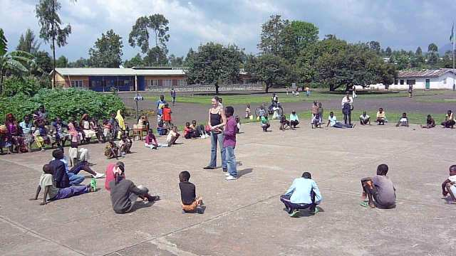

Slide 9
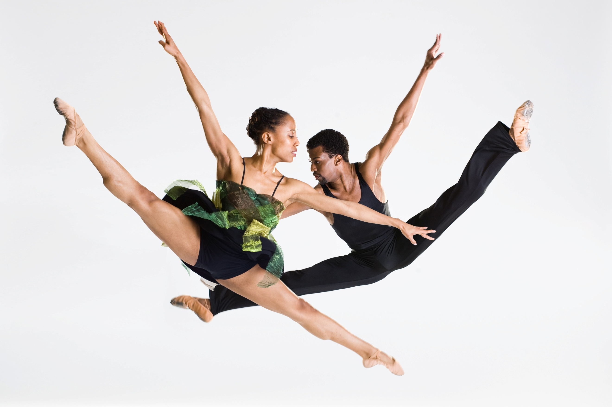

Slide 10
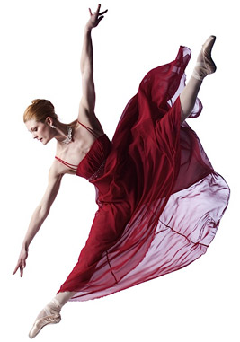
Background: RDDC
Not-for-profit organization founded in 2005 (USA)
Mission: to build sustainable projects in developing and post-conflict countries using dance training, performance and exchange as a tool of reconciliation in conjunction with community revitalization and economic development
Existing projects: Rwanda, Bosnia-Herzegovina, Guinea, USA
Professional USA Touring Repertoire: Antigone (2006), Helen Keller (2007), Darfur (2008), Greed: The Tale of Enron (2009), Van Gogh (2009), Braving the New World (2010)

Slide 11
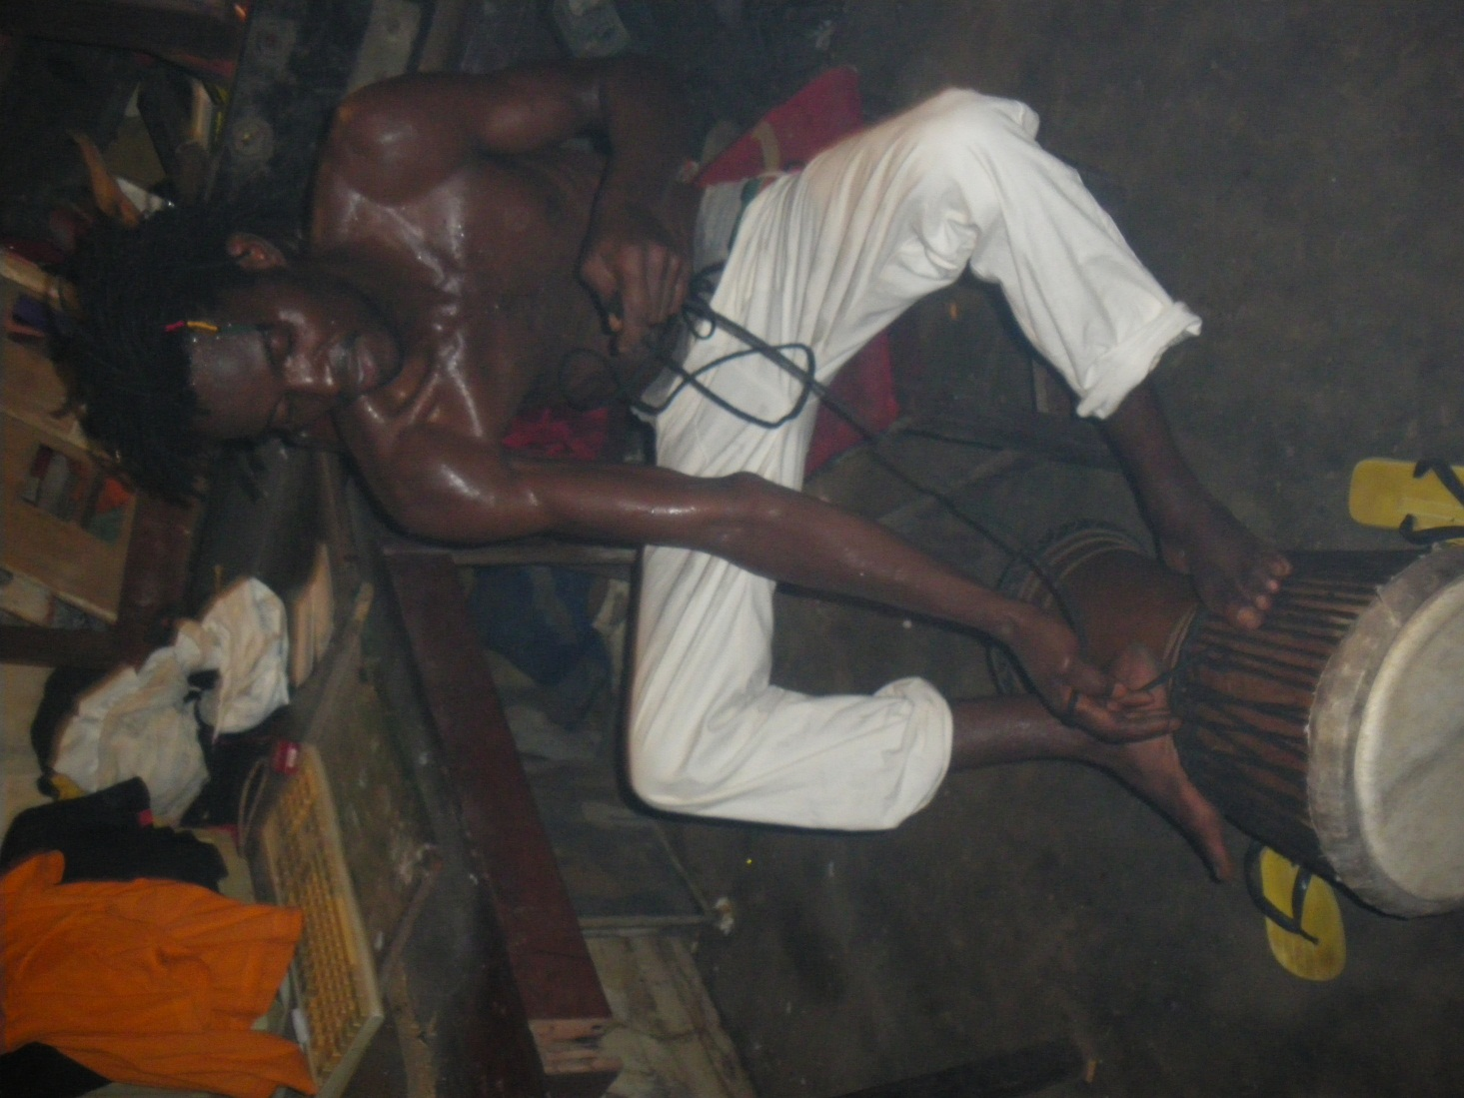
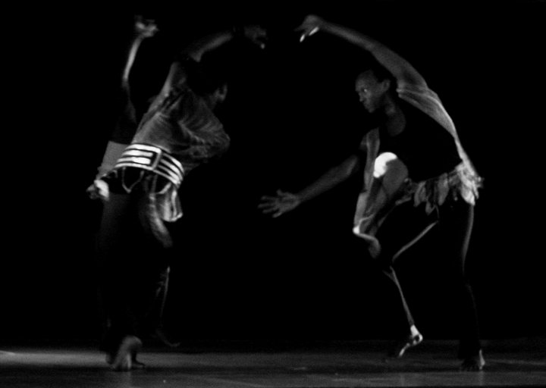
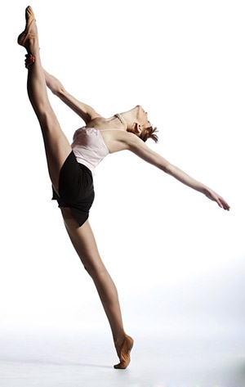
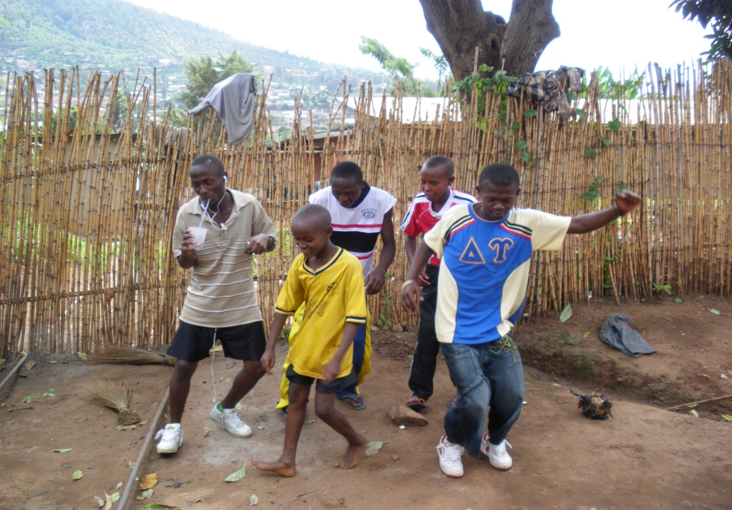

Slide 12

Rebecca Davis - Artistic Director
davis@rebeccadavisdance.com
USA: +1 215 840 3890
www.rebeccadavisdance.com
www.youtube.com/rebeccadavisdance
VIDEO of “The Water Project” in Rwanda (2010):
http://www.youtube.com/rebeccadavisdance#p/c/0A97EC7B1ED66D7C/3/6g8lgRqgL1A

